Slide 1
CSE7101- Capstone Project Review-1
PROJECT TITLE – ASK YOUR VET
Batch Number: CSD-42
Under the Supervision of,
ROLL NUMBER | NAME
20221CSD0123 | RAJASHREE S
20221CSD0131 | SANATH M
20221CSD0148 | NIHA NAAZ
Mr. Himansu Sekhar Rout Assistant Professor
School of Computer Science and Engineering, Presidency University
Name of the Program: Computer Science and Engineering (Data Science) Name of the HoD: Dr. Pravithraja S
Name of the Program Project Coordinator: Dr. H M Manjula Name of the School Project Coordinators: Dr. Sampath A K, Dr. Geetha A

Slide 2
Content
Project Title & Details – Ask Your Vet: Health and Sports, a digital veterinary care platform.
Problem Statement – Limited access, high costs, and lack of sports medicine expertise in animal healthcare.
Objectives – Provide accessible, affordable, and specialized veterinary advice with digital health records.
Background & Related Work – Human telemedicine is growing, but veterinary telemedicine is underdeveloped.
Literature Survey – Studies support telemedicine, preventive care, and sports health monitoring.
Gap Analysis & Innovation – Bridges rural access, adds sports vet focus, and digitalizes pet records.
System Architecture – Mobile app + backend with profiles, consultations, health records, and payments.
Technology Stack – Flutter, Django/Node.js, PostgreSQL/MongoDB, WebRTC, AWS/GCP.
Timeline (Gantt Chart) – 5 phases: research, prototype, backend, features, testing & launch.
Expected Outcomes – Better animal welfare, reduced costs, improved access, and scalable platform.
GitHub Link – Repository for code and collaboration
References – Research papers, VCI guidelines, telemedicine case studies.

Slide 3
Problem Statement Number: PSCS_699 - SOFTWARE
Problem Description:
This problem invites the development of a novel solution leveraging digital technology to address societal or administrative challenges within public services, sustainability, or governance
.
Key Issues:
Limited Accessibility – Rural and remote areas lack veterinary services.
High Costs – Minor health concerns still require expensive in-person visits.
Scarcity of Specialists – Sports medicine vets for performance animals are very few.
Poor Record Management – No centralized digital health records for pets/animals.
Low Awareness – Owners lack knowledge on preventive care, nutrition, and training.
Time Delays – Long waiting times for consultations in urban clinics.
Regulatory Challenges – Telemedicine and prescription rules require careful compliance.

Slide 4
Objectives
Obj 1: Provide veterinary care that is accessible and affordable through a simple digital platform.
Obj 2: Help owners easily connect with licensed vets and specialists, especially for sports and performance animals.
Obj 3: Maintain a centralized digital health record for each animal, making it easy to track vaccinations, treatments, and history.
Obj 4: Spread awareness about preventive care and nutrition in a clear, practical way for all types of owners.
Obj 5: Ensure the platform is safe, trustworthy, and compliant with telemedicine and data privacy laws.
Obj 6: Build a scalable and user-friendly solution that anyone, from city pet parents to rural farmers, can use without confusion.

Slide 5
Technology Stack Components
Layer | Components / Tools
Frontend (UI) | Flutter / React Native (mobile app), React.js (web dashboard), Figma/Adobe XD (design)
Backend | Django (Python) / Node.js (Express), RESTful APIs, JWT/OAuth2 (authentication)
Database & Storage | PostgreSQL (structured health data), MongoDB (chat/media), AWS S3 Storage
Communication | WebRTC / Twilio API (video calls), Firebase / Sendbird (chat), FCM (push notifications)
Cloud & Deployment | AWS / GCP / Azure (hosting), Docker (containerization), Kubernetes (scalability)
Security | SSL/TLS, AES encryption, Role-based access, Compliance with Data Protection laws
Payments & APIs | Razorpay / Stripe (payments), Integration with pet insurance & veterinary services (future)

Slide 6
Background & Related Work
Veterinary services in India are concentrated in cities, leaving rural owners underserved.
Owners of performance animals struggle to find experts in injury care and sports medicine.
Increasing pet adoption trends highlight the need for quick and affordable veterinary access.
Telemedicine in human healthcare shows proven success, but similar adoption for animals is minimal.
Most existing pet apps mainly offer shopping and grooming services rather than medical help.
Lack of digital health records makes continuity of animal care difficult.
Research supports preventive care and nutrition awareness to improve animal well-being.
There is still no integrated platform bringing vets, records, and sports health into one service.

Slide 7
Literature Survey Summary
Google docs link!

Slide 8
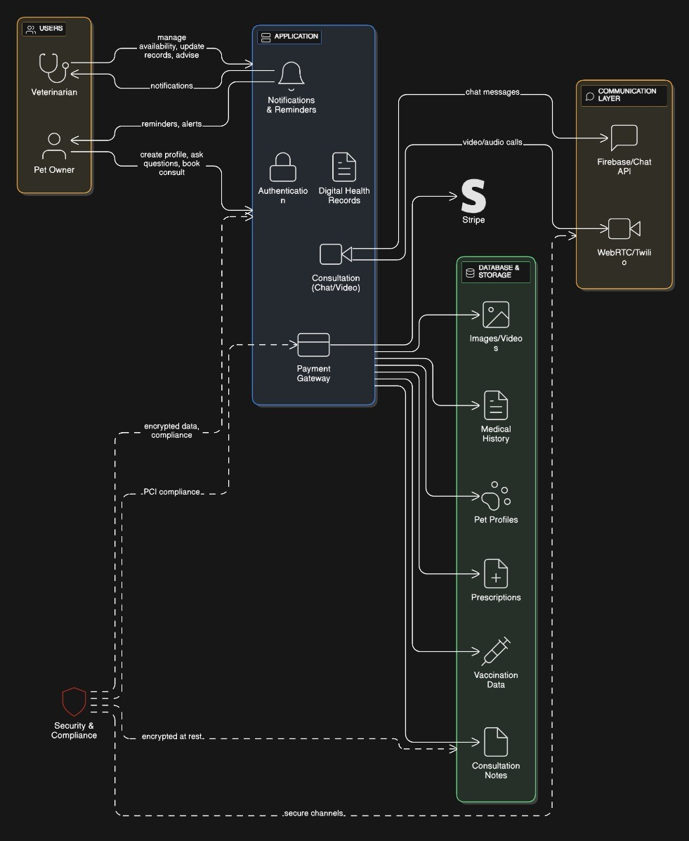
System Architecture

Slide 9
Gap Analysis & Innovation
Existing Limitation | Our Innovation
Limited vet access in rural/semi-urban areas | Digital telemedicine platform connecting owners with licensed vets
Scarcity of sports medicine specialists | Dedicated access to vets specializing in sports and performance animal care
No centralized animal health records | Unified digital health record system for pets and performance animals
High costs for minor consultations | Affordable online Q&A and triage before physical visits
Lack of preventive care awareness | Education modules on nutrition, vaccination, and training integrated in the platform
Fragmented pet apps (grooming/shopping focus) | End-to-end health + sports medicine + records platform
Poor continuity of care across clinics | Persistent digital history accessible to multiple vets
Regulatory uncertainty in telemedicine | Platform designed with compliance to VCI & data privacy laws

Slide 10
Expected Outcomes
Easy and affordable access to licensed veterinarians.
Timely advice for minor and preventive health issues.
Specialized care for sporting and working animals.
Centralized digital health records for pets and livestock.
Increased awareness of nutrition, vaccination, and preventive care.
Reduced travel and consultation costs for owners.
Scalable solution that can expand across regions

Slide 11
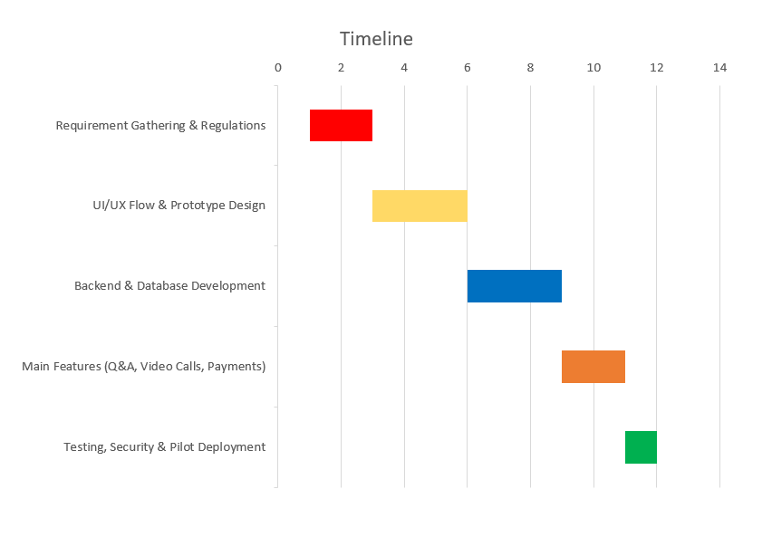
Timeline of the Project (Gantt Chart)
Phase 1 (Weeks 1-2): Focus on requirement gathering, defining scope (pets + sporting animals), and researching veterinary telemedicine regulations. Phase 2 (Weeks 3-5): Design user flow and develop prototype UI/UX for owner and vet interfaces. Phase 3 (Weeks 6-8): Build core backend and database for user/pet profiles, consultations, and digital health records. Phase 4 (Weeks 9-10): Implement main app features – Q&A, video consultations, notifications, and payment gateway. Phase 5 (Weeks 11-12): Testing, security checks, pilot deployment, and feedback collection for improvements.

Slide 12
Github Link
The GitHub repository provides public access to our project's source code, documentation, and development resources. You will find implementations of the mobile application, backend services, and database integration, along with setup instructions to run the system. The repository also includes API endpoints for consultations, health record management, and notification services. We welcome community contributions and feedback to enhance the platform and add future features like sports medicine modules and wearable integration
Github Link: https://github.com/SANATH00/CAPSTONE-PROJECT.git

Slide 13
References (IEEE Paper format)
[1] American Veterinary Medical Association, “Veterinary Telehealth: The Basics.” [Online]. Available: https://www.avma.org/resources-tools/animal-health-and-welfare/telehealth-telemedicine-veterinary-practice/veterinary-telehealth-basics
[2] B. A. Albadrani, M. A. Abdel-Raheem, and M. I. Al-Farwachi, “Veterinary telemedicine: A new era for animal welfare,” Open Vet. J., vol. 14, no. 2, pp. 493-500, Jun. 2024. [Online]. Available: https://www.researchgate.net/publication/380299043_Veterinary_telemedicine_A_new_era_for_animal_welfare
[3] L. M. Teller, “Exploring the challenges and opportunities presented by veterinary telemedicine,” Vet. Rec., vol. 191, no. 7, Sep. 2022. [Online]. Available: https://www.researchgate.net/publication/363420225_Exploring_the_challenges_and_opportunities_presented_by_veterinary_telemedicine
[4] D. Levine, A. P. Markley, D. J. Marcellin-Little, and H. Reesink, “Editorial: Sports medicine and physical rehabilitation, volume III,” Front. Vet. Sci., vol. 11, 2024. [Online]. Available: https://pmc.ncbi.nlm.nih.gov/articles/PMC11880228/
[5] T. Atalaia, J. Prazeres, J. Abrantes, and H. M. Clayton, “Equine Rehabilitation: A Scoping Review of the Literature,” Animals, vol. 11, no. 6, p. 1508, Jun. 2021. [Online]. Available: https://www.mdpi.com/2076-2615/11/6/1508

Slide 14
References (IEEE Paper format)
[6] D. S. Kronfeld, P. L. Ferrante, and D. Grandjean, “Optimal Nutrition for Athletic Performance, with Emphasis on Fat Adaptation in Dogs and Horses,” J. Nutr., vol. 125, no. 6S, pp. 1828S-1833S, Jun. 1995. [Online]. Available: https://www.researchgate.net/publication/15203528_Optimal_Nutrition_for_Athletic_Performance_with_Emphasis_on_Fat_Adaptation_in_Dogs_and_Horses
[7] T. L. Richards et al., “Effect of Total Starch and Resistant Starch in Commercial Extruded Dog Foods on Gastric Emptying in Siberian Huskies,” Animals, vol. 11, no. 10, p. 2928, Oct. 2021. [Online]. Available: https://www.mdpi.com/2076-2615/11/10/2928
[8] S. Burron et al., “Safety of Dietary Camelina Oil Supplementation in Healthy, Adult Dogs,” Animals, vol. 11, no. 9, p. 2603, Sep. 2021. [Online]. Available: https://www.mdpi.com/2076-2615/11/9/2603
[9] J. Atwal et al., “No Observed Adverse Effects on Health Were Detected in Adult Beagle Dogs When Fed a High-Calcium Diet for 40 Weeks,” Animals, vol. 11, no. 6, p. 1799, Jun. 2021. [Online]. Available: https://www.mdpi.com/2076-2615/11/6/1799
[10] C. Delsante et al., “An Online Survey of Pet Food Storage and Feeding Practices of Dog and Cat Owners,” Animals, vol. 11, no. 5, p. 1478, May 2021. [Online]. Available: https://www.mdpi.com/2076-2615/11/5/1478

Slide 15


